Slide 1


ROS 2 Humble
FUNDAMENTALS

Slide 2


What is ROS 2?
Robot Operating System 2 is a collection of software libraries, tools and conventions, for robots.
Open-source.

Slide 3
KEY FEATURES
DDS-based communication: Data Distribution Service for real-time, peer-to-peer, and reliable communication between nodes.
Real-time support: Real-time and deterministic control, crucial for industrial robots
Multi-robot support
Modularity: Software is built as nodes (small processes) that communicatee via topics, services, or actions.
Language support: C++ (rclcpp) and Python (rclpy) and others like Rust, Java, etc…
Security
Notes:
Peer-to-peer (P2P) describes a communication model where each participant (peer) can directly exchange data with others without a central server managing all the communication. Every node talks directly to every other node that it needs to — no “middleman.”

Slide 4
WORKSPACE
It is a simply directory containing the ROS 2 packages (your code) and a few special subdirectories.
ros2_ws/
├── src/ # Your packages (source code)
├── install/ # Built packages (after colcon build)
├── build/ # Temporary build files (after colcon build)
└── log/ # Logs from builds (after colcon build)
CREATE your own workspace:
$ mkdir -p ros2_ws/src
$ colcon build
Colcon build is the official build system of ROS 2.

Slide 5
SOURCING the BASH FILE and WS
The .bashrc is a hidden configuration file, located in the home directory.
Every time you open a new terminal, Linux runs the Bash shell which executes the commands in .bashrc to set up your environment.
$ source ~/ros2_ws/install/setup.bash
… it modifies your current shell session so you can use your workspace.
NB: If you close that terminal, the environment resets. So, to make it persistent, you add that line to your .bashrc file.

Slide 6

USING TURTLESIM, ROS2 and RQT
Now, let’s go to my GITHUB account…
https://github.com/giangalv/ROS2-Humble
Do not close the page, we will use it again sooner…

Slide 7
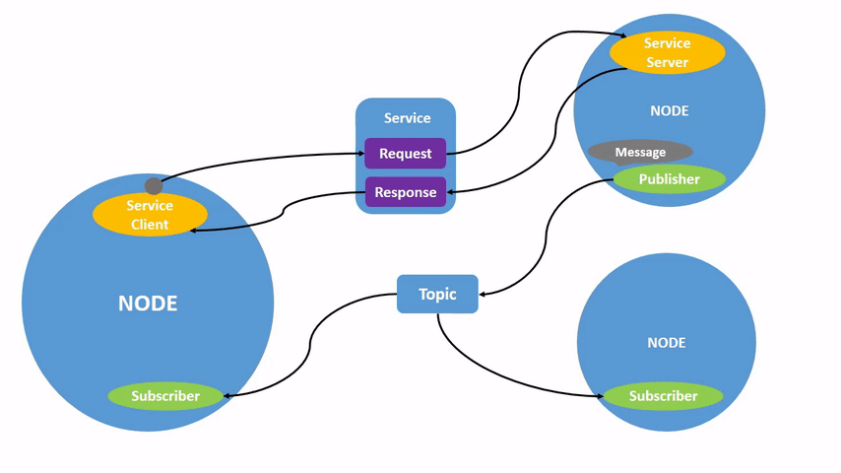
NODES
A full robotic system is comprised of many nodes working in concert.
Notes:
Each node in ROS should be responsible for a single, modular purpose, e.g. controlling the wheel motors or publishing the sensor data from a laser range-finder. Each node can send and receive data from other nodes via topics, services, actions, or parameters. In ROS 2, a single executable (C++ program, Python program, etc.) can contain one or more nodes.

Slide 8
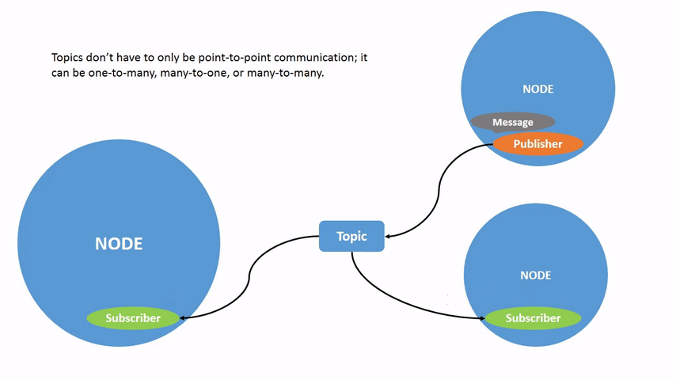
TOPICS
Topics are one of the main ways in which data is moved between nodes and therefore between different parts of the system.
Notes:
ROS 2 breaks complex systems down into many modular nodes. Topics are a vital element of the ROS graph that act as a bus for nodes to exchange messages. A node may publish data to any number of topics and simultaneously have subscriptions to any number of topics.

Slide 9
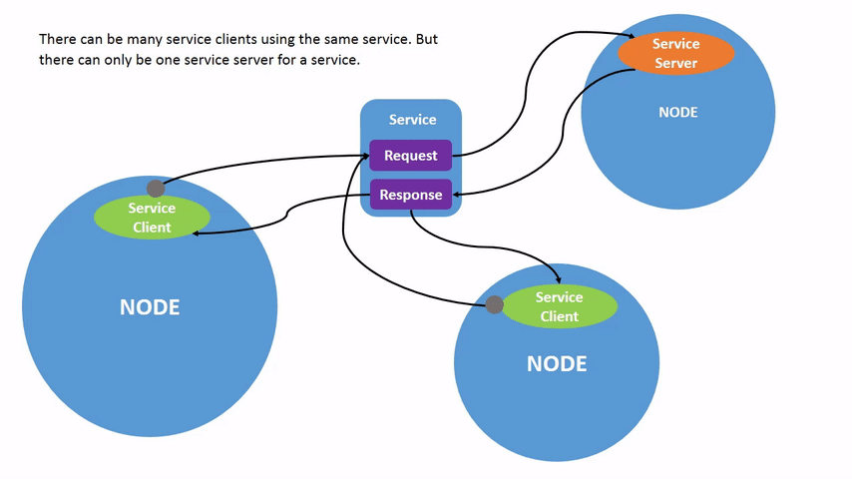
SERVICES
Services only provide data when they are specifically called by a client.
Notes:
Services are another method of communication for nodes in the ROS graph. Services are based on a call-and-response model versus the publisher-subscriber model of topics. While topics allow nodes to subscribe to data streams and get continual updates, services only provide data when they are specifically called by a client.

Slide 10
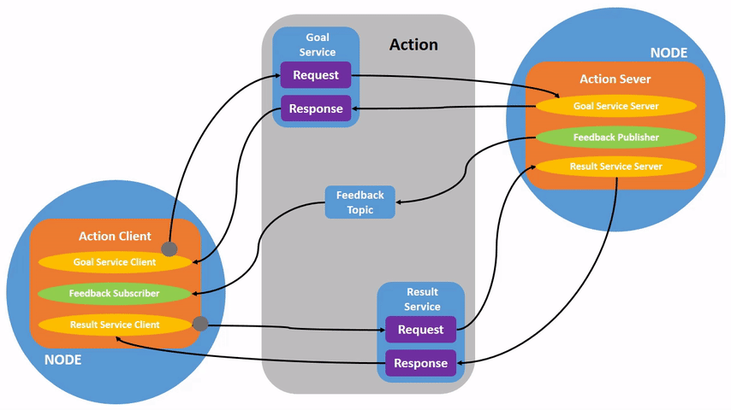
ACTIONS
Actions consist of three parts; a goal, feedback, and a result.
Notes:
Actions are one of the communication types in ROS 2 and are intended for long running tasks. They consist of three parts: a goal, feedback, and a result. Actions are built on topics and services. Their functionality is similar to services, except actions can be canceled. They also provide steady feedback, as opposed to services which return a single response. Actions use a client-server model, similar to the publisher-subscriber model. An “action client” node sends a goal to an “action server” node that acknowledges the goal and returns a stream of feedback and a result.

